Slide 1

Dwaraka Nilayam
(Glimpse of Grandeur – Electronic city Ananthnagar)
(BMRDA Approved Flats)

Slide 2
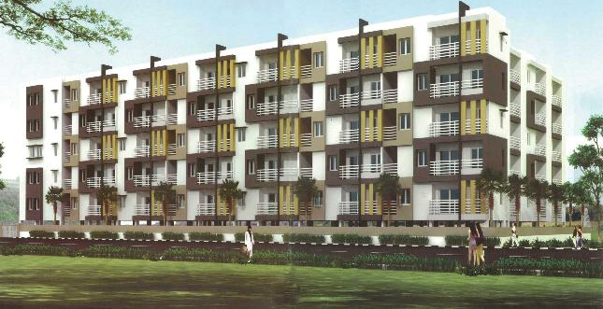
Glimpse of Grandeur: Welcome to a lifestyle that translates itself into a perpetual vacation, the moment you desire. Fun and entertainment for the entire family is guarantee.

Slide 3
Description:-
Step outside your home to welcome the wide array of luxury that capture your imagination at every moment of life. All this & many more in your kingdom.
Come & enjoy the beauty of the location & peaceful atmosphere around “Dwaraka Nilayam”
Dwaraka Nilayam is a complex of 70 well-designed 2 & 3 Bedroom Apartments
That sprawl across 5 floors.
Completion : April 2014
Location: Ananthnagar, Electronic city phase II
1.5 kms from Hosur main road

Slide 4
Amenities:-
Gym
Party Hall
Swimming pool
Children Play area
LandScaped Area
Intercom
Power Backup
24 Hours Security
Rain Water Harvesting
Club House

Slide 5
Specification:-
Structure: RCC framed structure.
Walls: 6” cement solid blocks for exterior walls & 4” cement solid blocks for internal walls.
Doors: Main Doors Teak wood frame with teak panel & all other doors salwood frame with flush shutters.
Windows: Powder coated 3 track Aluminum windows with safety grills.
Flooring: Vitrified flooring for hall, Dinning, Kitchen, Bedrooms & Balconies.
Kitchen: Granite Slab of 30mm thick & stainless steel sink, Glazed tiles dado upto 2ft height above the platform.
Electrical work: Concealed copper wiring with branded switches & scockets.

Slide 6
Toilets: ceramic tiled flooring & glazed tile dado upto 7’0” height with branded fittings & white colour sanitary ware.
Finishing: Emulsion paint for internal walls & polish for wood & Enamel paint for wood & steel grills, exterior with apex paint.
Water Supply: water supply from BOREWELL with overhead tank & sump
Car Parking: Exclusive covered car parking at basement.
T.V & Telephone: Individual T.V & Telephone point in Living, Master bedroom & A/C Point in Master bedrooms.
Lift Facility: Two lift of minimum 6 passenger capacity
Generator: Power backup for individual flat, common area & Lift.
Intercom: For all flats.

Slide 7
Know your neighbourhood

Slide 8
NEARBY EDUCATIONAL INSTITUTES
Christ Academy
St.Francis De Sales
Treamis World School
Acts Secondary School
Ebenezer School
Colleges
ACTS College
BTL IT
PESSE
SFS College
SFS Junior PU College

Slide 9
Management Schools and other Institutes
1.IHMR - Institute of Health Management Research 2.NTTF - Nettur Technical Training Foundation 3.ISBR - International School of Business Research 4.IBMR - Institute of Business Management & Research 5.ICFAI International School of Business and Research 6.IFIM Business School 7.IIIT - International Institute of Information Technology 8.Noble Institute of Education Society 9.SIBM - Symbiosis Institute Of Business Management 10.Welingkar Institute of Management Development & Research 11.XIME - Xavier Institute of Management and Entrepreneurship

Slide 10
Medical Shops
1. Apollo Pharmacy 2.Ram Medical 3.Madhu Medicals 4.Trust Chemists & Druggists 5.Shanti Medicals 6.Balaji Medicals
NEARBY HOSPITALS
1.Vimalalaya Hospital 2.Apollo ECity 3.Ramakrishna Health Care 4.Acts Health Centre 5.Swami Hospital 6.Dr.Agarwal Eye Hospital
7. Narayana Hrudayalaya

Slide 11
COMPANIES IN THE VICINITY OF PROJECT
1. Bharat Heavy Electricals Ltd.
2. Biocon Limited
3. CGI Information Systems Pvt Ltd.
4. Flextronics Technologies India Pvt Ltd.
5. Fortune Infotech Ltd.
6. HCLTechnologiesLtd.
7. Hewlett-PackardGlobalSoftLtd.
8. Infosys Technologies Ltd.
9. Hinduja Global Solutions Ltd.
10. Mahindra Satyam
11. Patni Computer Systems Ltd.
12.Robert Bosch Engineering Ltd..
13. Satyam Infoway - Sify
14. Wipro Technologies
15. Yokogawa India Ltd. and many more

Slide 12
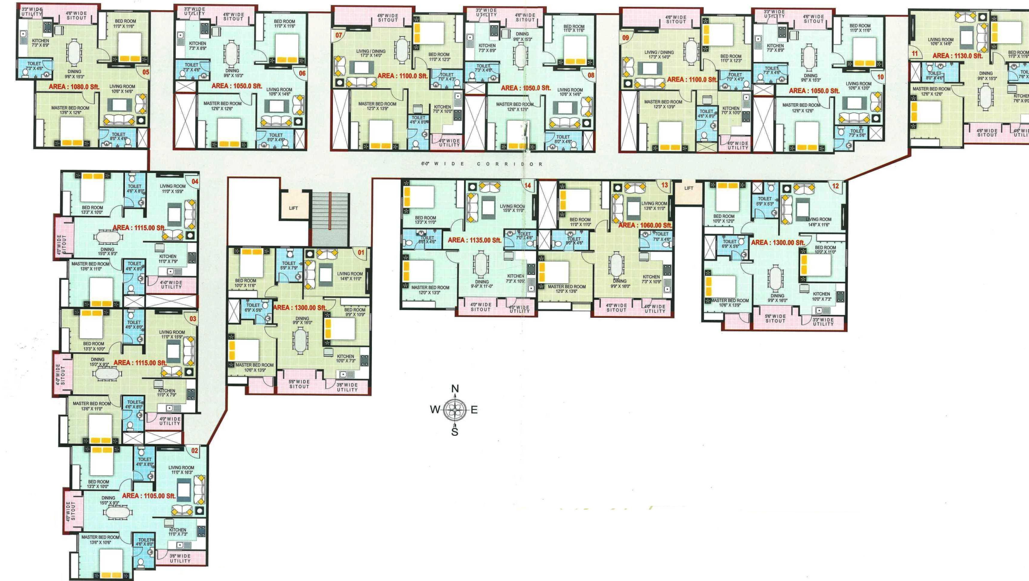
Layout Plan:-

Slide 13
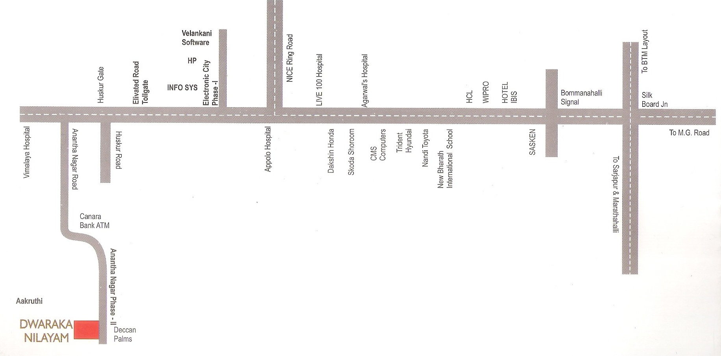
Location Map:-

Slide 14

For further clarification contact
Keshava
9916485861
Marketing Executive
Venetion Group

